Slide 1
COMPREHENSIVE
DIGITAL MARKETING PROJECT
ON CADBURY
Team ID : LTVIP2023TMID03517
Team Size : 5
Team Leader : VADAPALLI SOUJANYA
Team member : SHEIK KHARISHMA
Team member : VAJRAKAYALA ANVITHA
Team member : BUGATHA VATSALYA
Team member : VEMPARALA V V D ANURADHA PRIYA

Slide 2
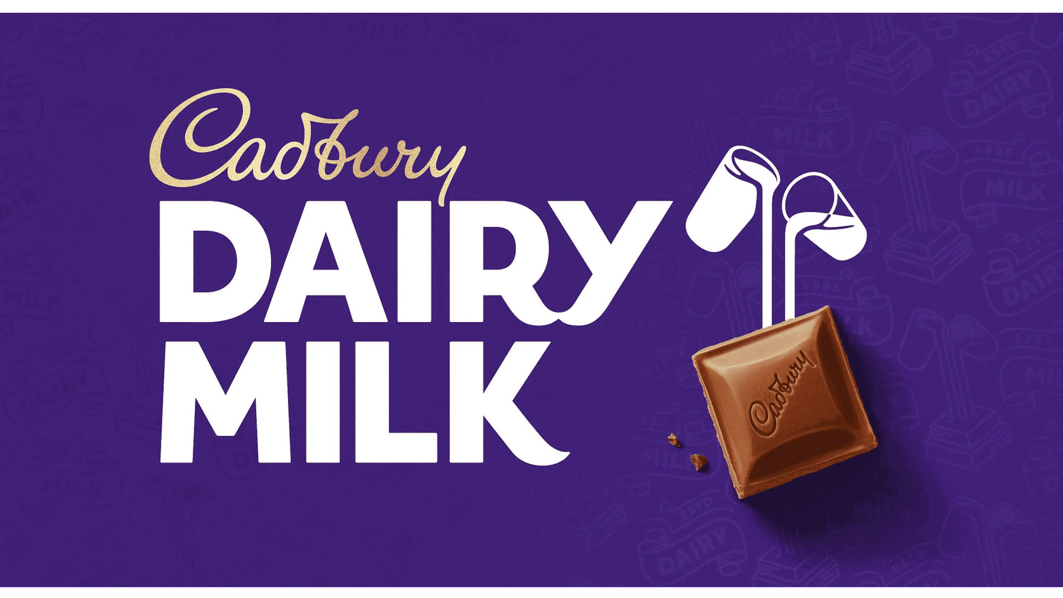

Slide 3



PART 1- BRAND STUDY
Brand Identity:
Mission : to continually create the best products, services and experiences for our customers, and to be the leading player in the global confectionery market.
Values:Quality, Integrity, Respect, Responsibility, and Joy.
USP:Cadbury is one of the biggest and most trusted chocolate brand worldwide
Brand color- puple (shade Pantone 2685C), (tribute to queen victoria)
Brand logo-
Note: the design of the logo has changed to match the style and audience of the age.each logo represents different decade audience

Slide 4
Analyze Brand Messaging: there's a generous instinct within everyone.
Cadbury's brand message, "There's a generous instinct within everyone," emphasizes the idea that inherent in all individuals is a natural tendency towards generosity. The message seeks to tap into the universal human trait of compassion and kindness, suggesting that people have the capacity to be generous and giving. By aligning its brand with this positive and relatable concept, Cadbury aims to create an emotional connection with its audience, encouraging them to associate their product with acts of generosity and goodwill. This message likely resonates with consumers, fostering a sense of warmth and positivity towards the Cadbury brand.
Examine the brand's tagline:'Taste like this feels
Cadbury's tagline, "Taste like this feels," suggests that the taste of their products is so delightful and satisfying that it creates a unique and pleasurable experience for the consumer.'

Slide 5
PART 1- Competitor analysis
Competitor:1 https://www.kinder.com/us/en/bueno-us-landing-page| DECADENCE COMES IN MANY SIZES|CRISPY WAFER|SMOOTH CHOCOLATE|CREAMY HAZELNUT FILLING
Competitor2: https:\\www.nestle.com\\
|NUTRITION BASED PRODUCTS|AFFORDBLE SALES|EXPLORING WITH VARIOUS BRANDS|
Competitor 3:https://www.ferrerorocher.com/it/it/
| DECORATIVE OUTCOME| ALL ROUND SALES WITH AFFORDBLE PRICES | MORE NUTRITIVE VALUES|
|

Slide 6
Part 1: Buyer’s/Audience’s Persona
Demographics:
- Age: 25-45
Gender: Male and female
Family Status: Married with young kids or single
Income: Middle to upper-middle class
Location: Primarily urban and suburban areas of india
Psychographics:
Values: Seeking moments of happiness, joy, and relaxation
Interests: Enjoys indulging in sweet treats, trying new flavors, and experimenting with food
Lifestyle: Busy with work and family responsibilities but appreciates moments of relaxation
Attitudes: Prefers high-quality products and enjoys sharing experiences on social media
Aspirations: Seeks products that offer a sense of comfort and nostalgia

Slide 7
Behaviors:
Purchase Behavior: Buys chocolates regularly, especially during holidays and special occasions
Media Consumption: Active on social media, follows food influencers and food-related content
Online Behavior: Engages in online shopping and searches for product reviews and recommendations. Active on social meia
Brand Loyalty: Has a positive perception of Cadbury, as it evokes feelings of joy and tradition
Interests:
Food and Flavors: Interested in trying new and unique flavors of chocolates and snacks
Family and Socializing: Enjoys sharing chocolates and treats with family and friends
Health and Wellness: Concerned about making healthier choices but also craves occasional indulgence
Holidays and Celebrations: Seeks chocolates as gifts during festive occasions and holidays

Slide 8
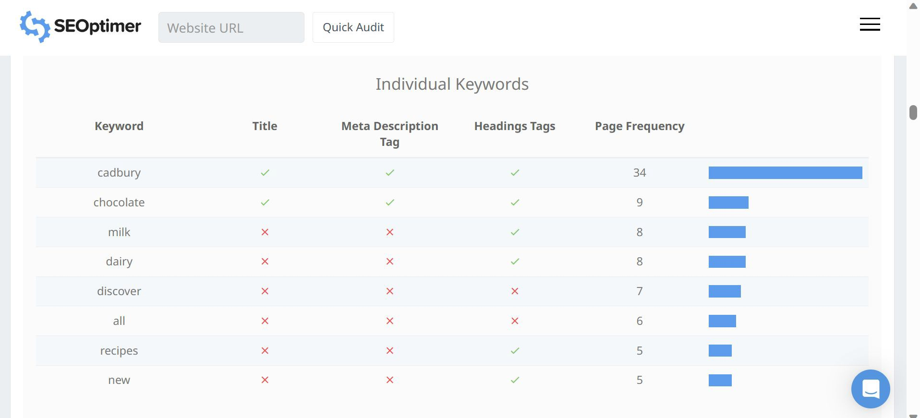
Part 2: Keyword Research

Slide 9
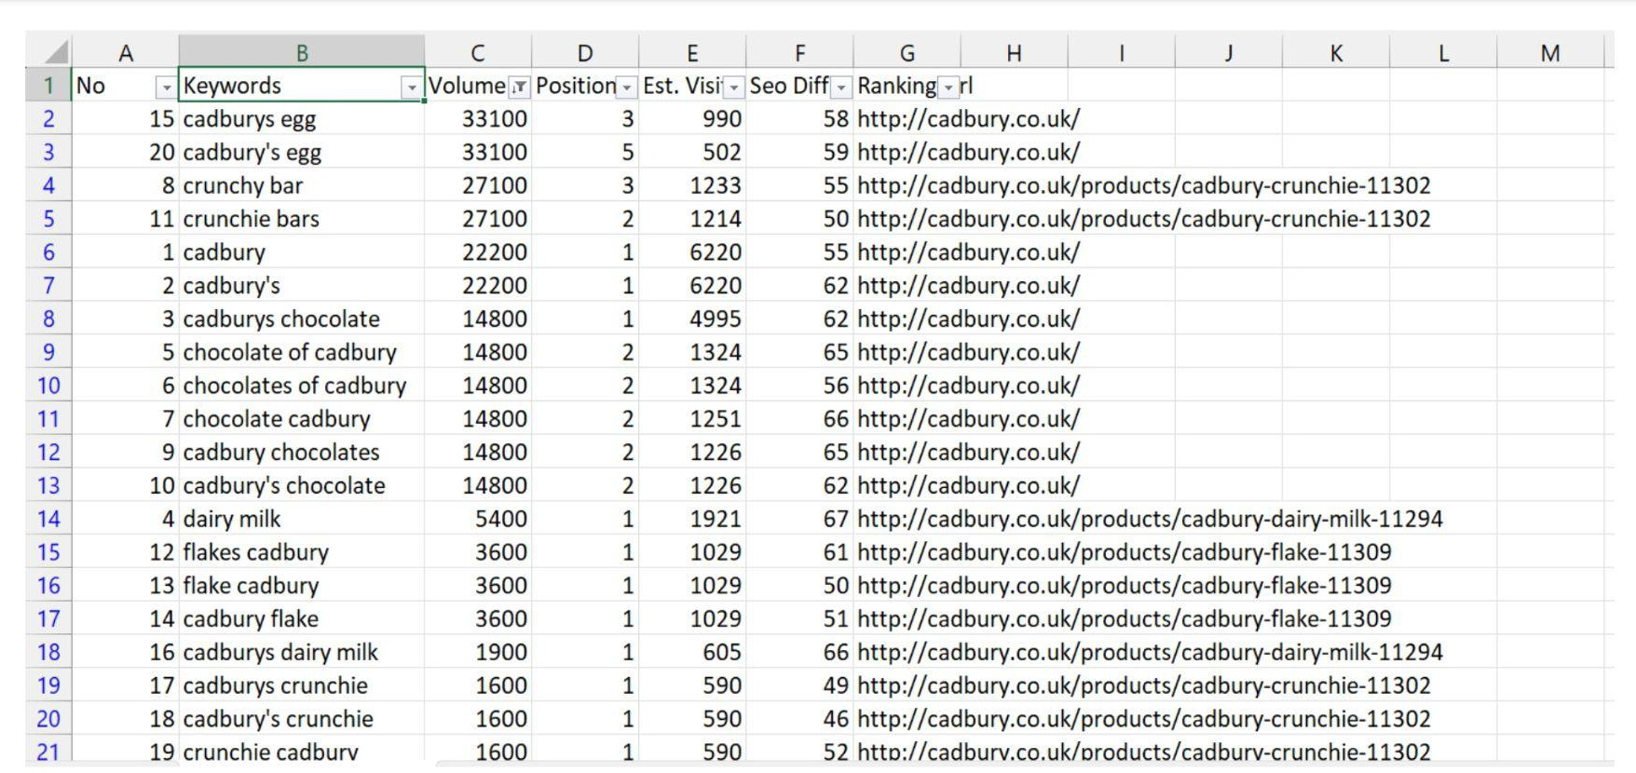

Slide 10
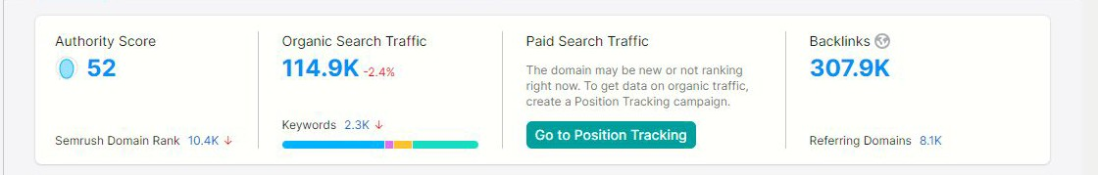
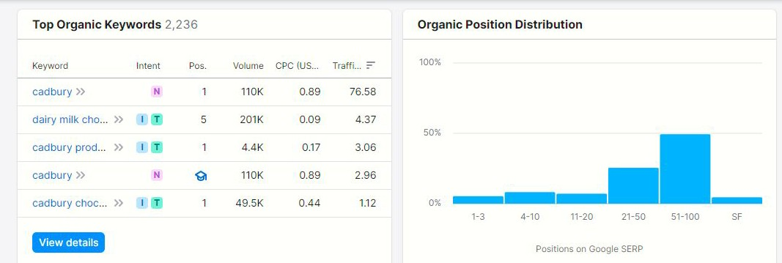
Part 2: SEO AUDIT
(audit is done in semrush app)

Slide 11
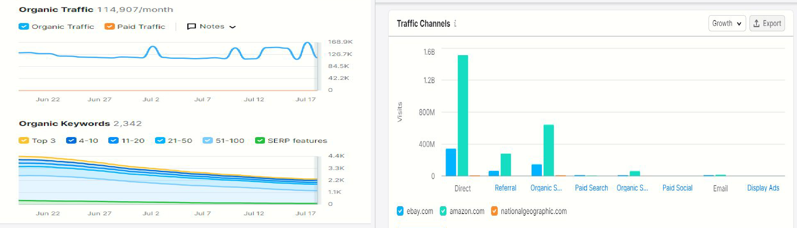
Part 2: SEO & Keyword Research

Slide 12
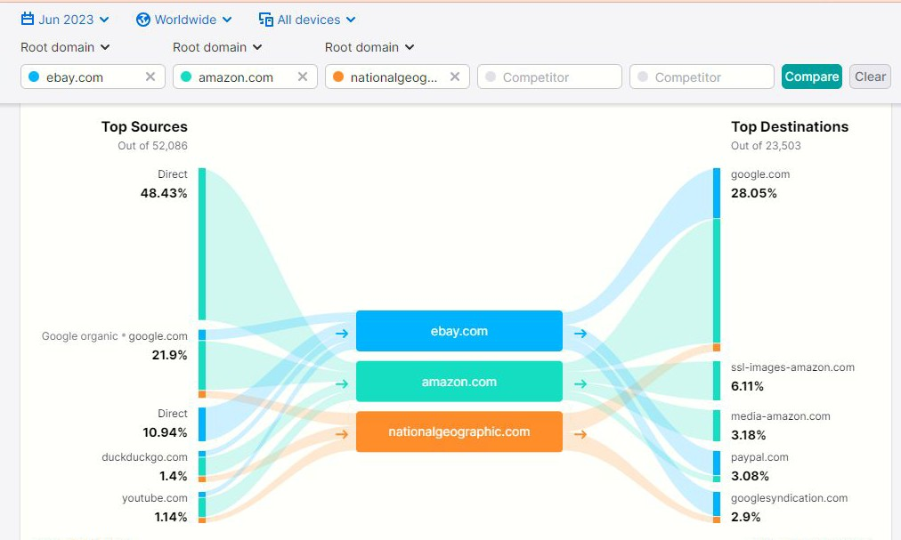
Part 2: SEO & Keyword Research

Slide 13
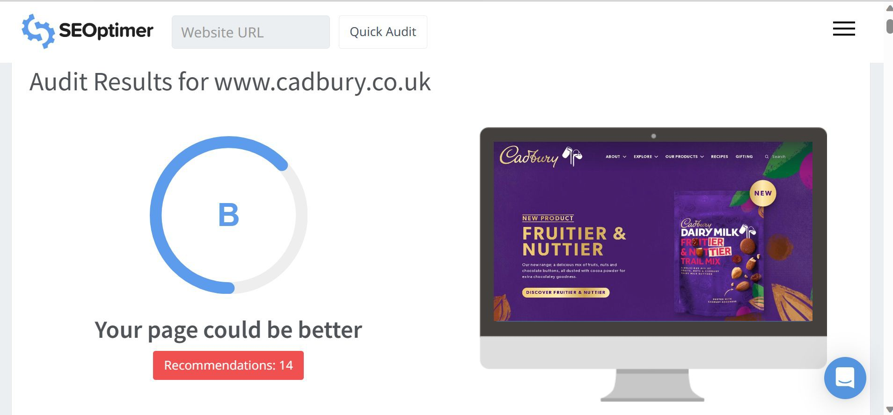
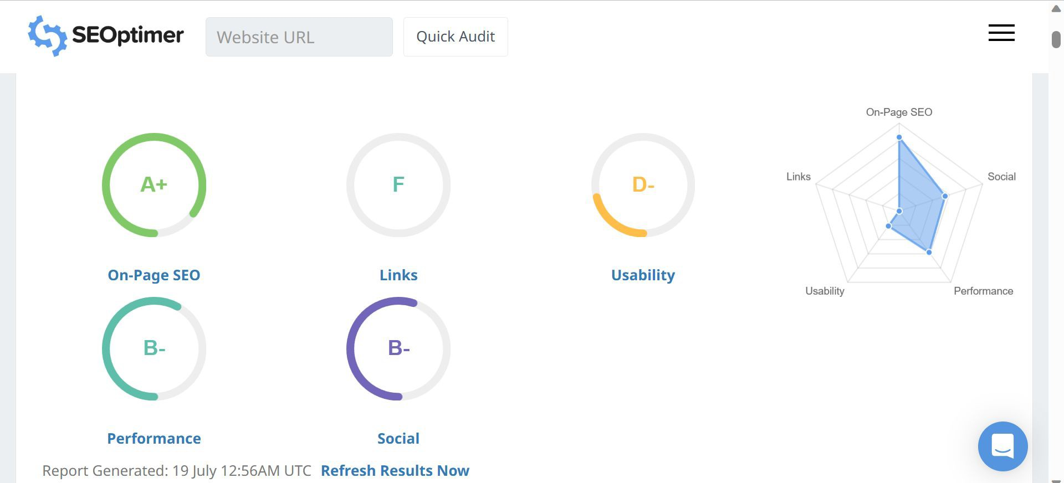
Part 2: SEO & Keyword Research

Slide 14
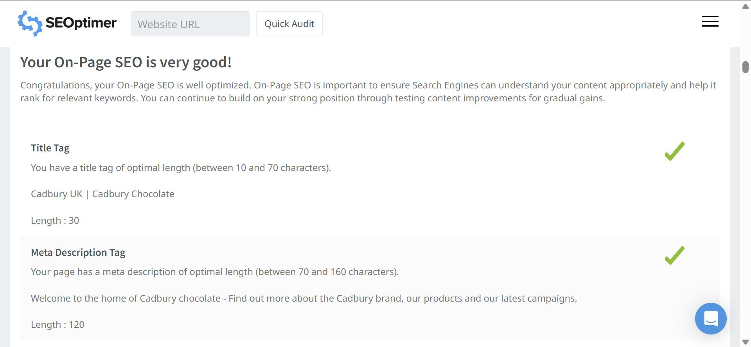

Slide 15
On page optimization
Meta tag optimization-
Title Tag: "Delightful Cadbury Chocolates | Irresistible Flavors & Quality Treats"
Meta Description: "Indulge in the world of Cadbury chocolates, featuring a delightful array of irresistible flavors and premium quality treats. Explore our range of creamy, smooth, and satisfying confections today."
Keywords: Cadbury chocolates, irresistible flavors, quality treats, creamy, smooth, indulgence

Slide 16
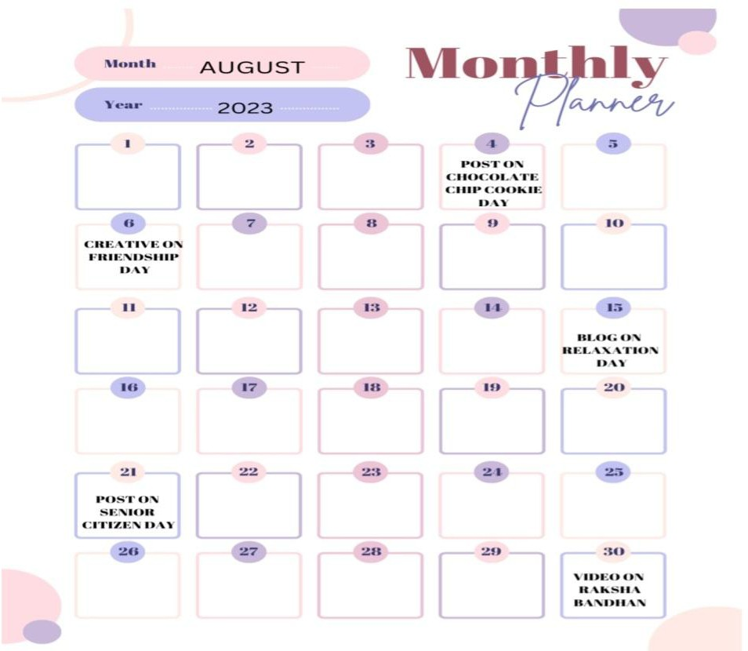
Content idea generation & strategy
Part 3: Content Ideas and Marketing Strategies
Content calendar for August month

Slide 17

Format 1
CREATIVE ANIMATED POST GIF FILE
Aim: To create website traffic
Date: 6th August 2023
Concept: Friendship day
https://www.instagram.com/reel/CvJoM6SuZFL/?igshid=MmU2YjMzNjRlOQ==

Slide 18
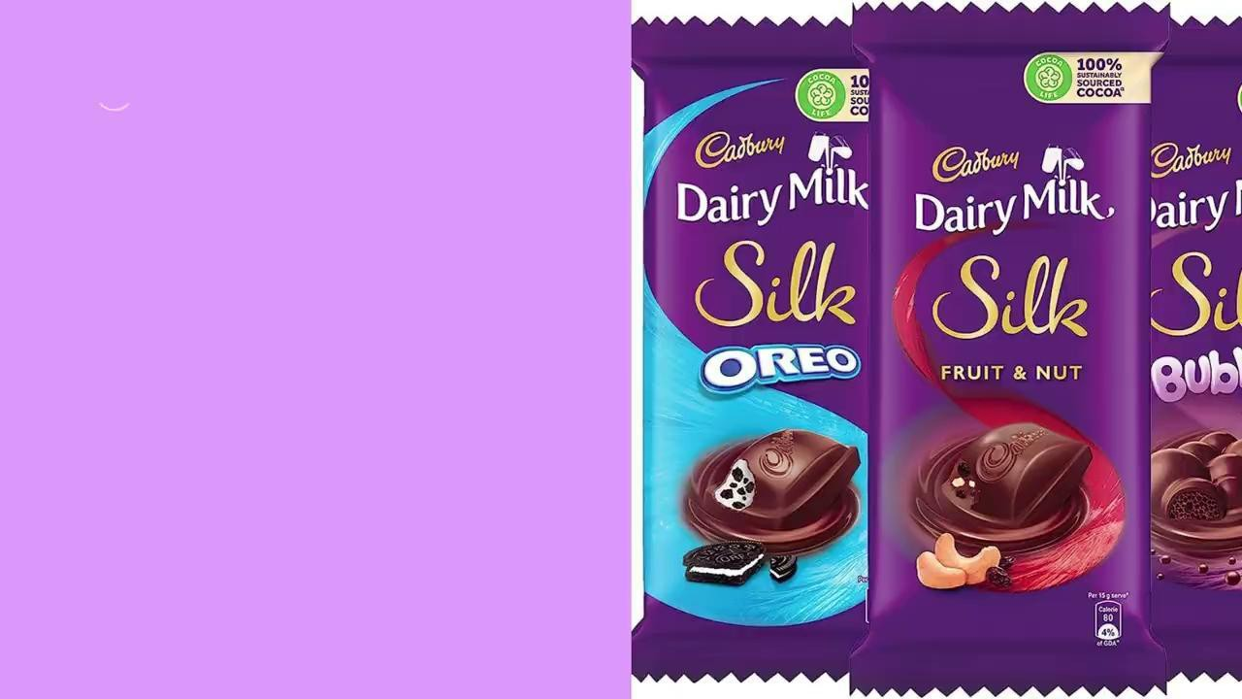
FORMAT 2 - short video

Slide 19
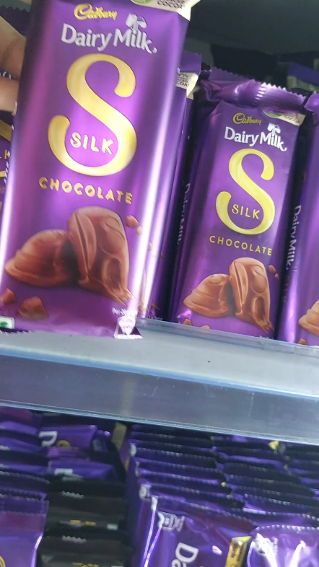
Format 3
VIDEO
Aim: To increase Brand awareness
Concept: Raksha Bandhan
Insta reel https://www.instagram.com/reel/CvJqo_-RpXN/?igshid=MmU2YjMzNjRlOQ==

Slide 20
Content Ideas and Marketing Strategies
Reflect on the content ideas and marketing strategies process, discussing the challenges encountered and lessons learned.
To discuss with the main point, all the strategies and ideas were brainstormed together to make the plan and implement successfully.
A calendar was first made by using Monthly planner in CANVA platform. All the possibilities were discussed and the dates & tasks were assigned respectively.
Accordingly, we made the posts, blogs, creatives were made using CANVA SOFTWARE and video was made using VN VIDEO EDITOR.

Slide 21
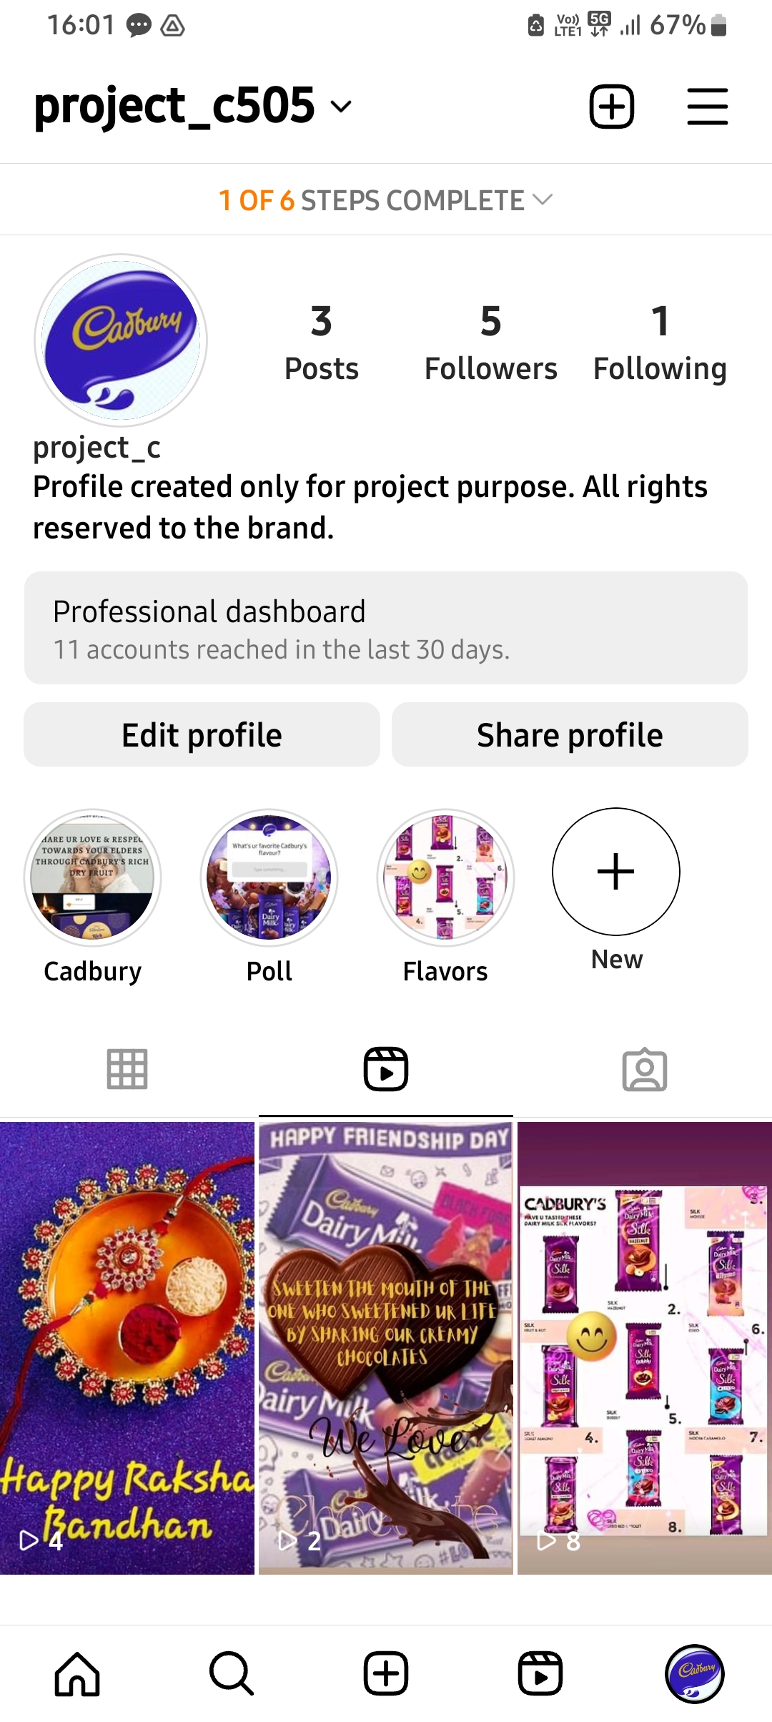
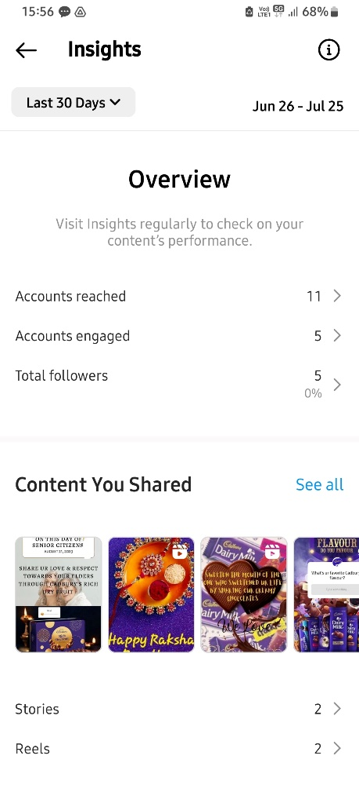
Instagram
Created an Instagram account
Switched to professional account and got access to professional dashboard and insights.
Created some designs in canva & then uploaded into insta stories and posts.
Also utilised the story highlights

Slide 22
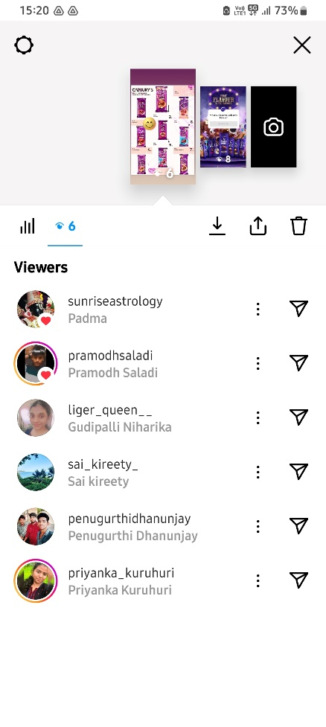
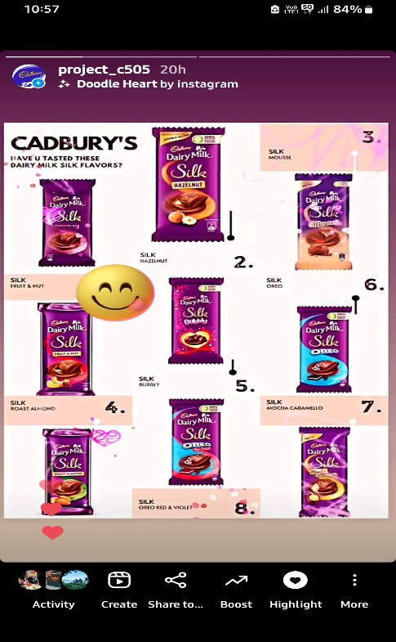
Instagram story 1
Story 1

Slide 23
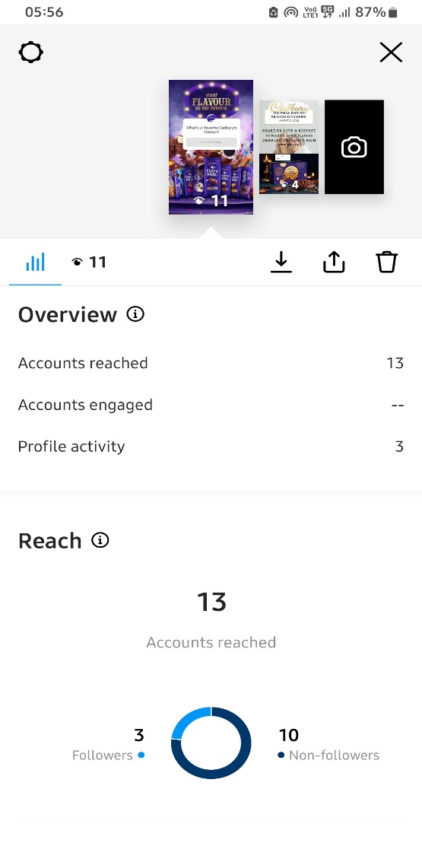
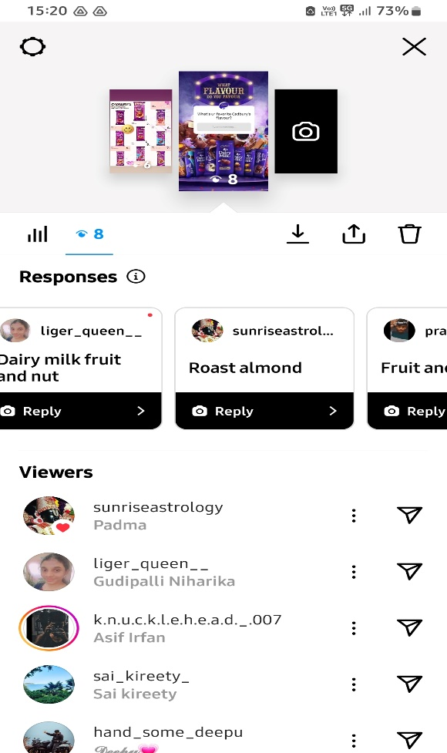
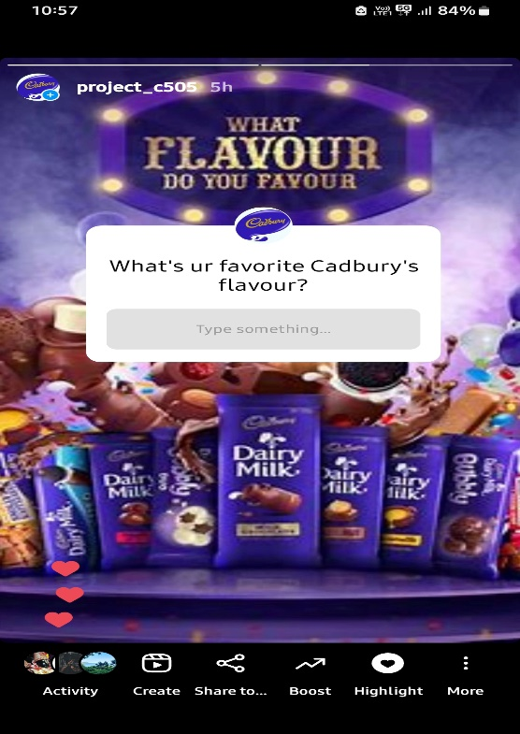
Instagram story2

Slide 24
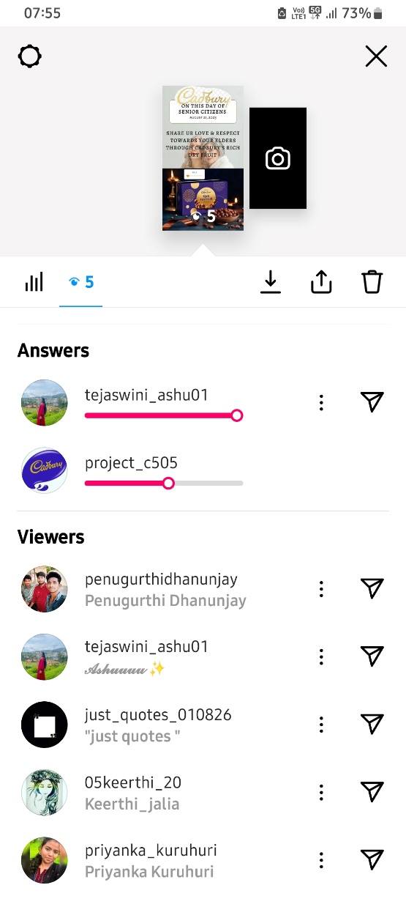
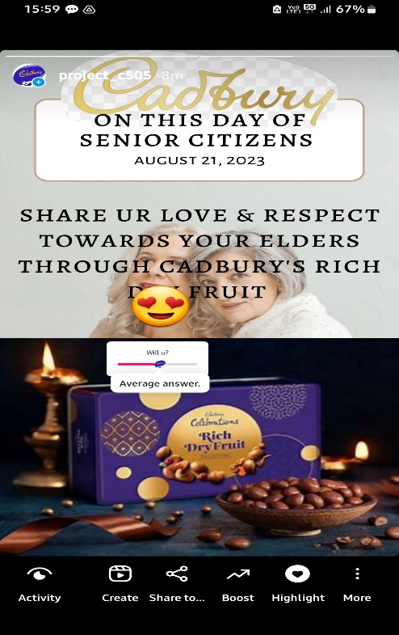
Instagram story 3

Slide 25
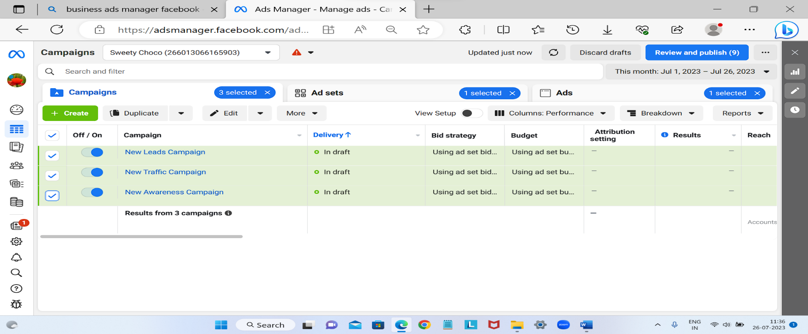
Social media ad campaigns
https://www.facebook.com/profile.php?id=100094735406975&mibextid=ZbWKwL

Slide 26
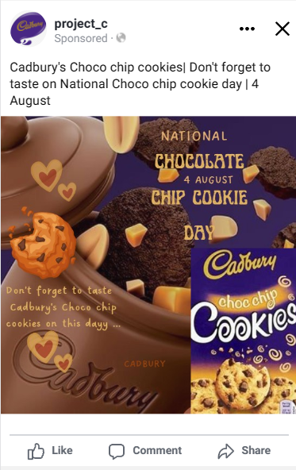
Facebook
META AD CAMPAIGN
FACEBOOK : BRAND AWARENESS
LOCATION : INDIA
TARGET AUDIENCE: AGE 18-50
GENDER: ALL
AUDIENCE TYPE: BROAD
https://fb.me/262rio0rw9efeA8

Slide 27
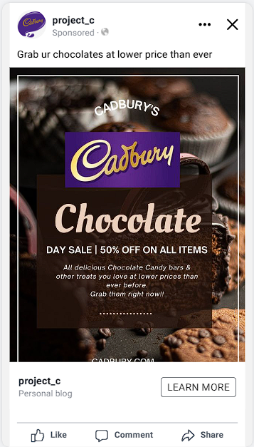
Facebook
FACEBOOK TRAFFIC CAMPAIGN
LOCATION : INDIA
TARGET AUDIENCE: AGE 18-50
GENDER: ALL
AUDIENCE TYPE: BROAD

Slide 28
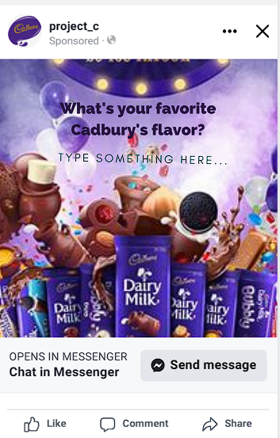
Facebook
FACEBOOK LEADS GENERATION
LOCATION : INDIA
TARGET AUDIENCE: AGE 18-50
GENDER: ALL
AUDIENCE TYPE: BROAD

Slide 29
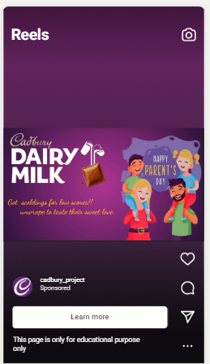
Insta
Cadbury traffic campaign-
https://fb.me/20OZsww0fzHWPVt
Location- india
Target audience-18 to 65+age
Interests-desserts,chocolate,chocolate brownie or oreo,dairy milk,
Industry-food and dairy

Slide 30
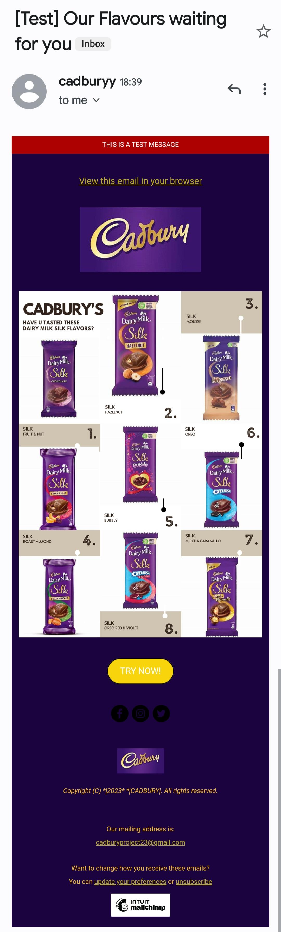
Email ad campaign 1
EMAIL AD CAMPAIGN DONE IN MAILCHIMP
BRAND AWARENESS

Slide 31
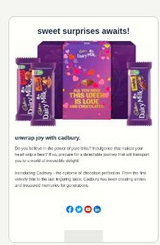
Email Ad Campaign 2 - Lead Generation

Slide 32
Content Creation and Curation (Post creations, Designs/Video Editing, Ad Campaigns over Social Media and Email Ideation and Creation)
Reflect on the content creation and curation process, discussing the challenges faced and lessons learned.
Our team, consisting of Vatsalya, Priya, Soujanya , Kharishma and Anvitha have learned a lot from the content creation and curation process.
Some of the challenges we faced were finding reliable sources, organizing the information, and presenting it in an engaging way.
We overcame these challenges by conducting effective research, evaluating the credibility of sources, and using various tools viz. canva & vn editor and techniques to create and edit content.
This process helped us improve our skills and knowledge in digital marketing as a project team

